Slide 1

Optimization of Sales and Customer Payment Analysis in Brazilian E-Commerce
Team Members : Achinthya Sreedhar, Bilvika Basetty, Kaushiki Tiwary, Saketh Bollina, Crystal Leatvanich
https://www.linkedin.com/pulse/optimizing-e-commerce-strategies-insights-from-olists-pradeep-kumar-vpc2c

Slide 2
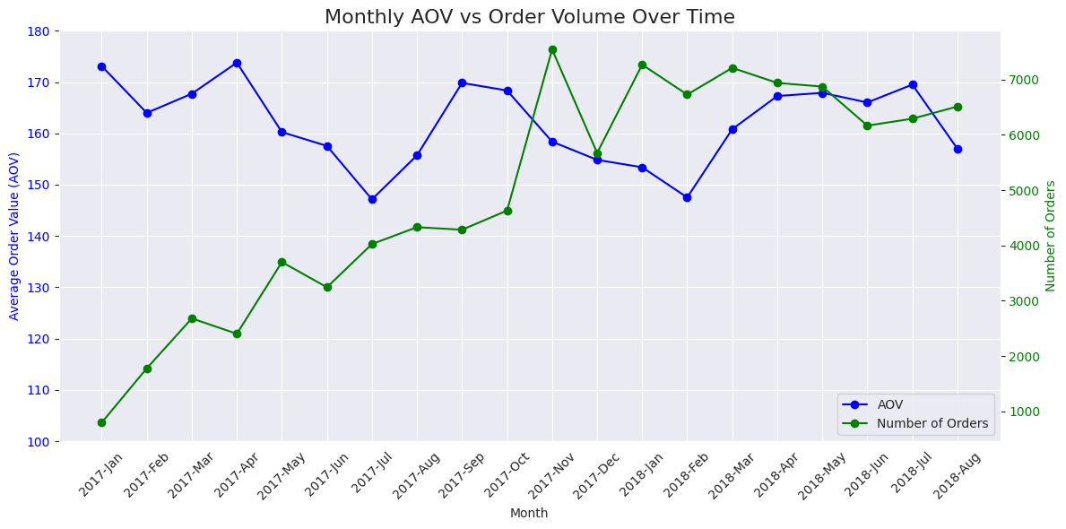
An Overview of Olist’s Growth (2017-18)
Number of Orders
Significant increase since inception in 2015
Average Order Value
Stable, indicating increase in customers but not the average spending per order
Total Customers Gained
Total Revenue
AOV Range
96,096
16,008,872 R$
140 - 180 R$

Slide 3
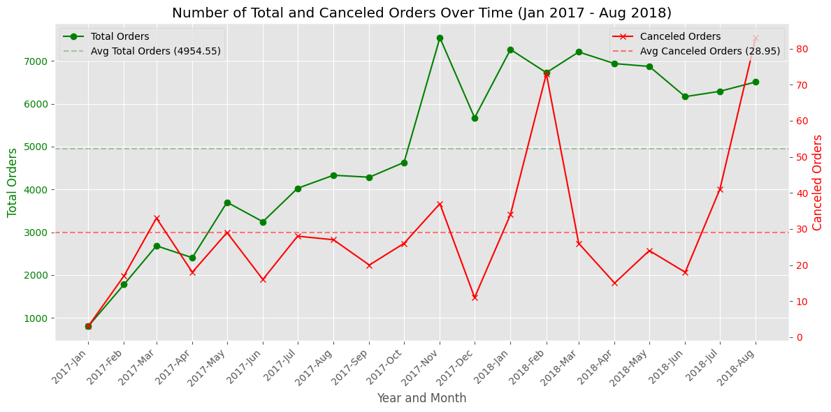
Total Orders Vs Canceled Orders
Key Insights
Canceled orders are much lower, averaging 28.95, compared to 4954.55 for total orders
There are a few sharp spikes in cancellations: early 2017, late 2017, and mid-2018
Total Orders
Canceled Orders
99,091
579

Slide 4
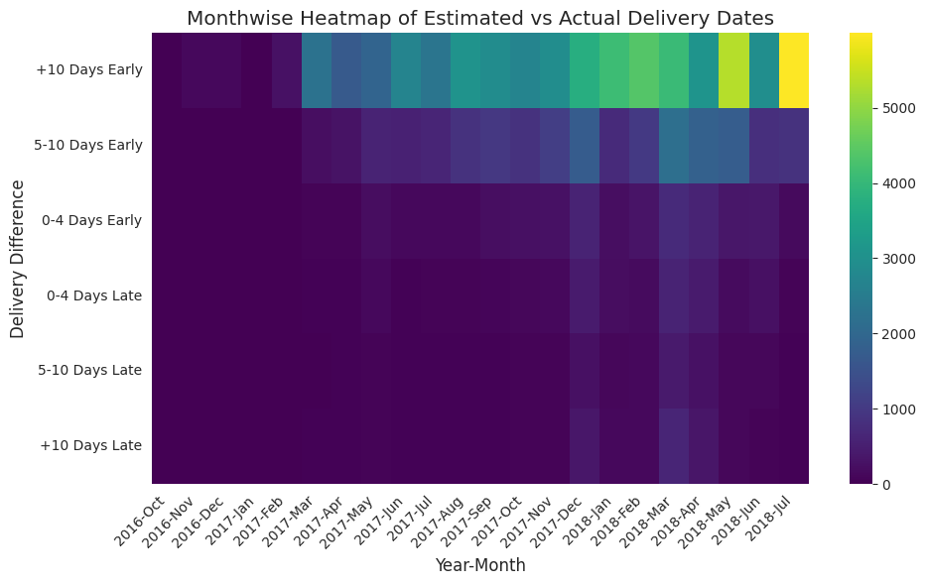
Estimated Vs. Actual Delivery Timeline
Key Insights From October 2016 to July 2018, the company significantly improved its ability to deliver packages earlier than expected
The majority of orders are arriving 10 or more days ahead of the estimated schedule provided to customers
Setting delivery estimates too far in the future may discourage customers from placing orders, impacting potential sales

Slide 5
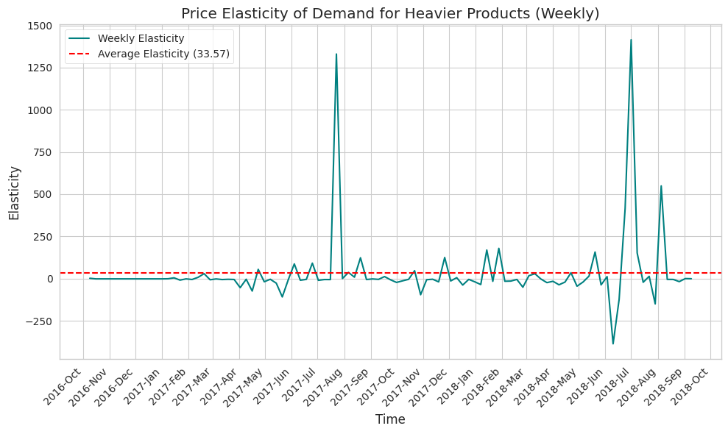
Demand Sensitivity to the Change in Price of Heavier Products
Key Insights
Significant peaks in mid - 2017 and mid - 2018, indicates high sensitivity to price changes
Causal factors - could be influenced by promotional events and seasonal demand shifts
Stable demand outside of peak times
Negative elasticity - periods where price increases did not reduce demand, possibly due to strong consumer need or lack of substitutes

Slide 6
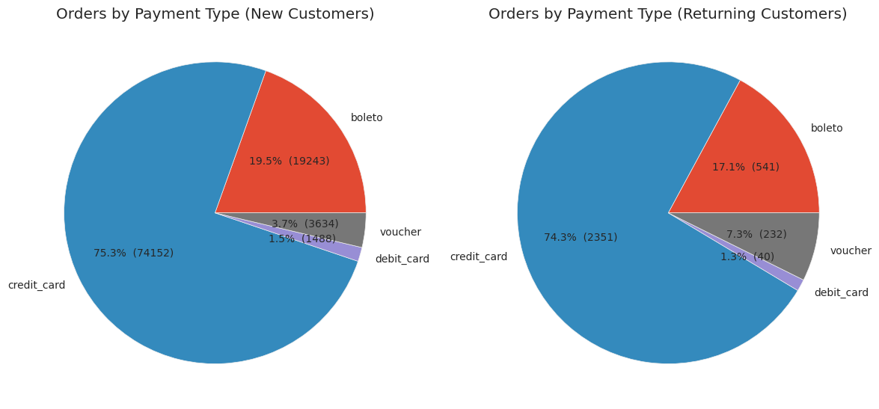
Orders by Payment Type
Voucher usage between
new and returning customers
Possible marketing or retention tool
Voucher: New Customers
Voucher: Returning Customers
3.7% / 3,634
7.3% / 232

Slide 7
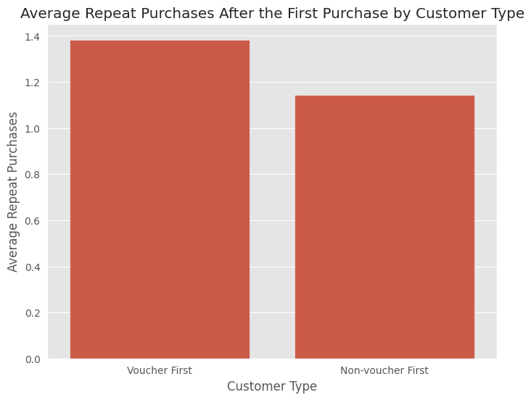
Repeat Purchases by Customer Type
Vouchers drive customer retention
Expand voucher usage as a marketing and customer retention tool

Slide 8
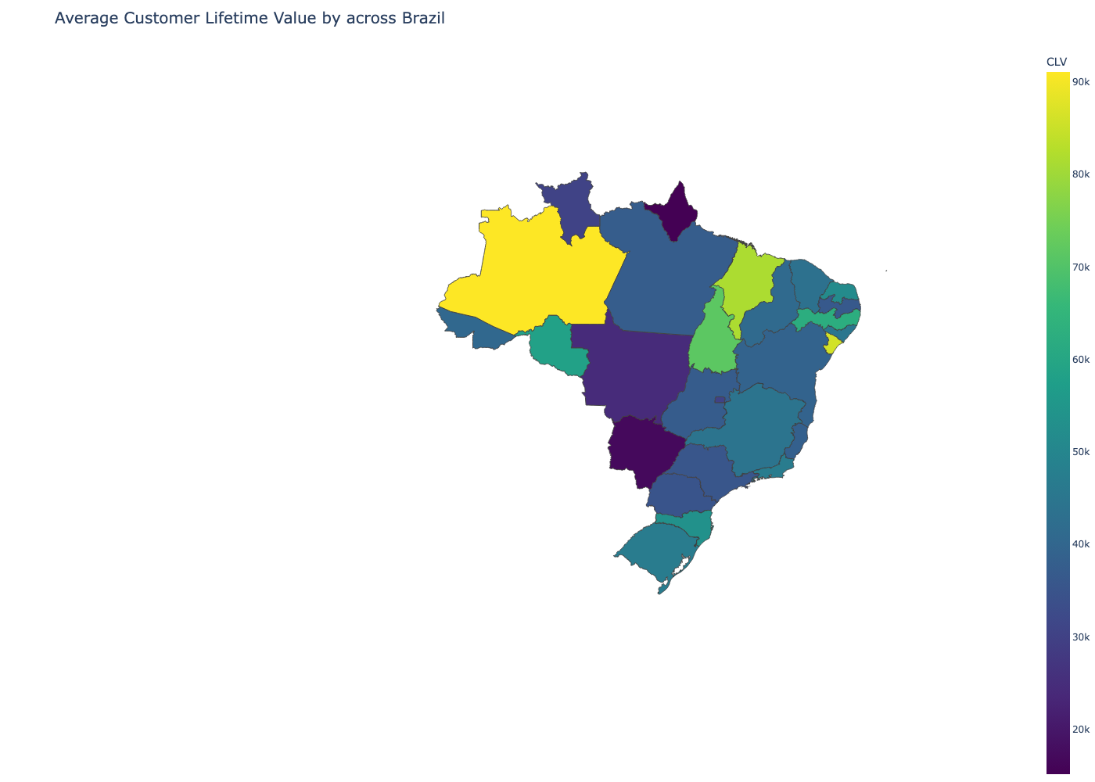
Customer Lifetime Value Across Different States in Brazil
CLV Classification
Customer Lifetime Value (CLV)
High-CLV: 70-90k
Growth potential-CLV: 50-70k
Low-CLV: <50k
The total revenue expected from a customer over their relationship with the business.
02
Amapá
(AP)
Rio Grande do Norte
(RN)
Geographic Segmentation
Amazonas (AM)
Metrics
Jupiter
Maranhão
High-CLV: AM, SE, MA
Growth potential-CLV: TO, PE, RO, RN
Low-CLV: AP, MS, SP
$6.9M
Average Order Value (AOV)
Purchase Frequency (f)
Customer Life-Span* (T)
(MA)
Jupiter is a gas giant and the biggest planet
Staff costs
Rondônia
Tocantins
(RO)
(TO)
CLV Calculation
Sergipe
Insights & Propositions
(SE)
CLV = AOV x f x T
% of returning customers: 2.4%
Low-frequency purchases in Sao Paulo
High-CLV: Customers Retention [loyalty programs]
Low-CLV: Improve offerings, affordability, and logistics
Promote installment options and voucher payments
04
Pernambuco
(PE)
Untapped Customers
Mato Grosso do Sul
(MS)
93,975
Mercury
$8.9M
São Paulo
Mercury is the closest planet to the Sun
(SP)
Rent costs
Choropleth Map of Brazil: CLV across different states
Notes:
Customer Lifetime Value, or CLV measures the total revenue expected from a customer over their entire relationship with the company. It is crucial for identifying the most valuable customers and understanding where to focus resources for maximum profitability.
pandas methods like groupby and merge were applied to calculate the following metrics To visualize the results, a choropleth map was created using a contrasting gradient to clearly show the variation in CLV across regions. And this variation was classified into high Value, growth potential and low value regions as follows:
This map provided insights into the proportion of returning customers and shows that there is a large customer base that the company has to to tap into with tailored promotional strategies. For Low Value regions like AP and MS the company needs to focus on understanding and tailoring their products as per the customer needs and for those regions with High Value customers the company needs to leverage various loyalty programs. For the growth potential regions the strategy is to promote installment options and voucher payments to optimize and avoid cart abandonment which is preventing from these states being high value

Slide 9
Summary
Customer Segmentation and Satisfaction
Identify distinct customer groups and their purchasing behaviors
Product and Sales Performance
Opportunities for optimizing inventory management, product recommendations, and promotional strategies
Price Elasticity
Suggest flexible pricing strategies during periods of high elasticity could increase revenue
Customer Payment Preferences
Tailor promotions and streamline the payment process

Slide 10
Questions?

Slide 11
Appendix

Slide 12
#2. How do the total orders and canceled orders fluctuate over time?

Slide 13
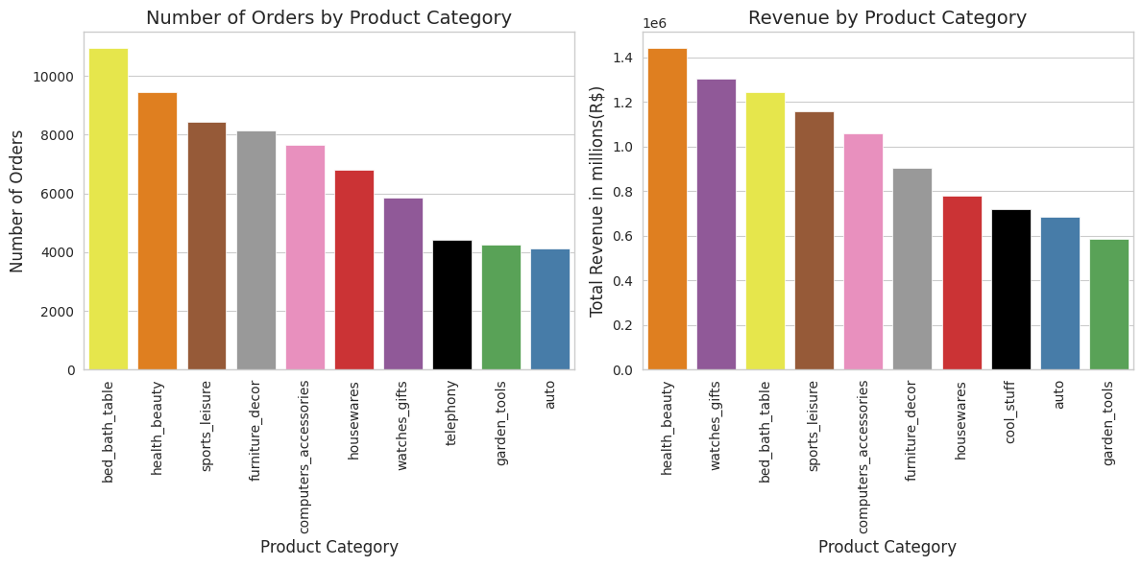
#3. What are the Differences Between Product Categories Driven by the Most Order Volume and Revenue?

Slide 14
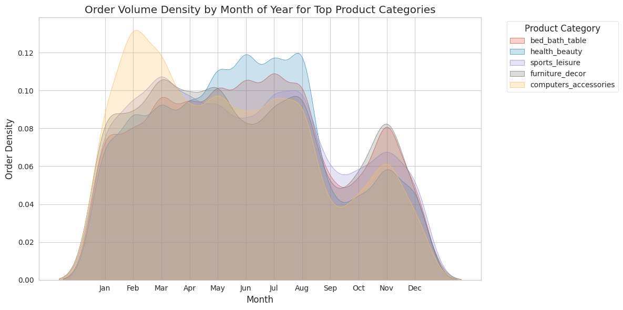
#4. How does order volume vary across the year for top product categories?

Slide 15
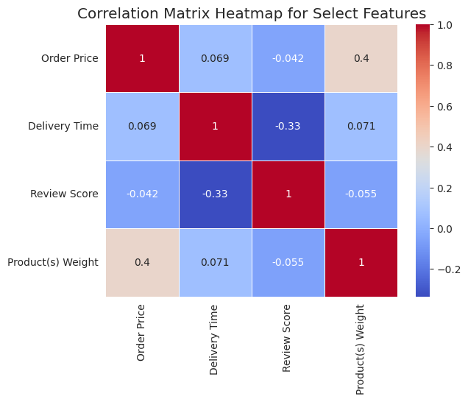
#5. How do product characteristics, delivery time, and price influence customer review scores?

Slide 16
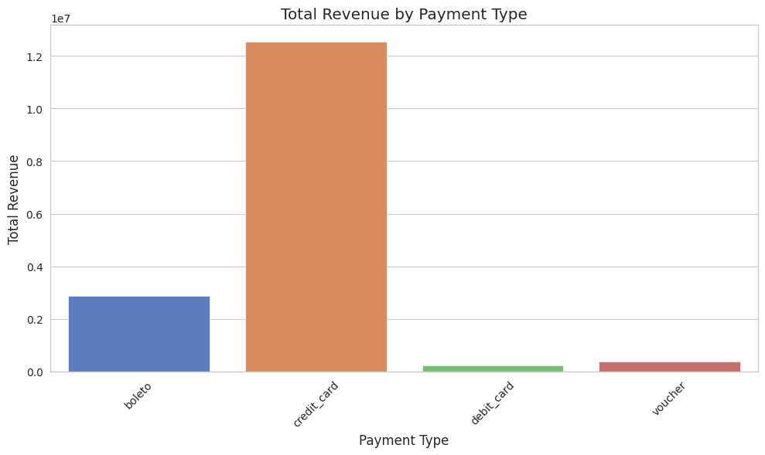
#8. How much revenue is flowing through each payment type?

Slide 17
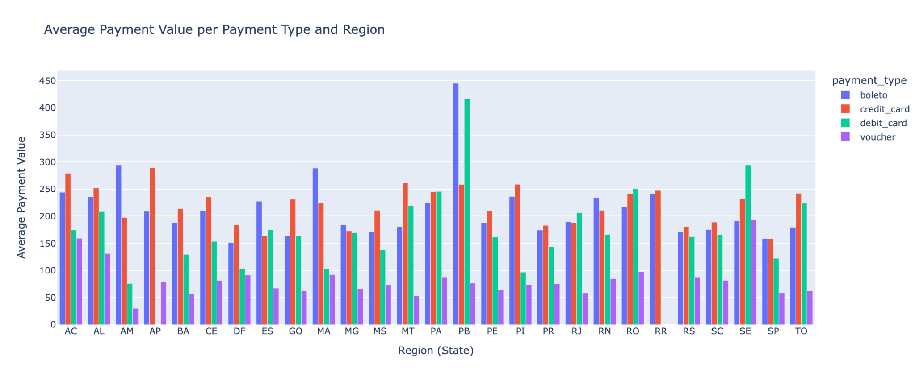
#9. What are the payment preferences across different states?

Slide 18
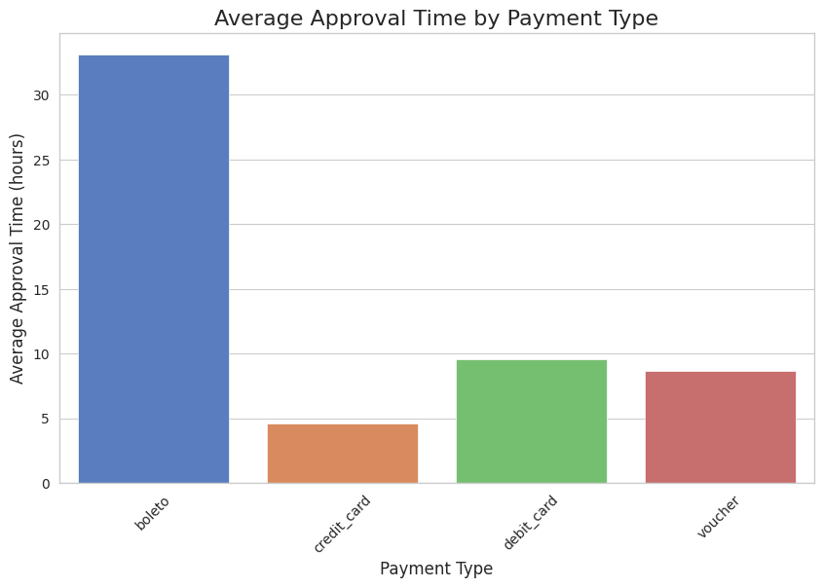
#10. What is the average approval time for different payment types?

Slide 19
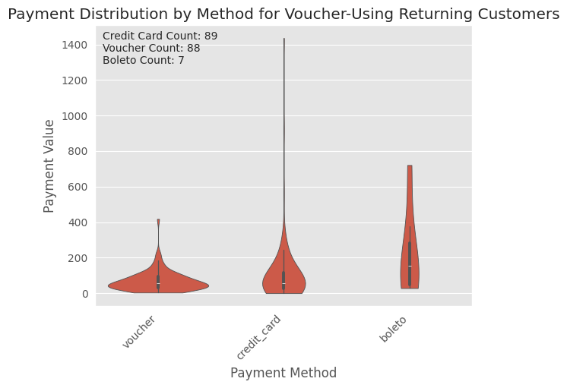
#12. How effective are vouchers as a marketing tactic in encouraging customers to make repeat purchases?

